Slide 1


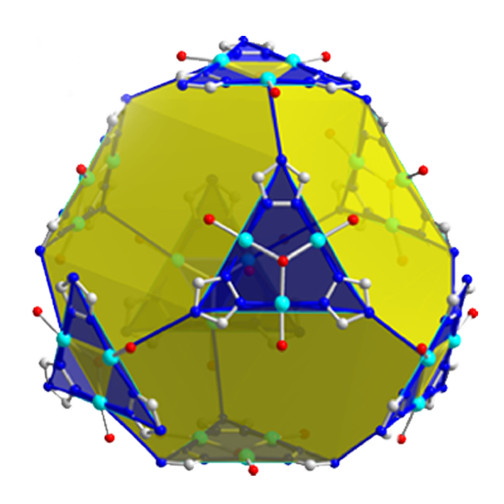
Your Name
Nickname: Here
Team: Here
bit.ly/MagLabSciBall

